Slide 1
Face Mask Detection using Convolutional Neural Network (CNN)
PRESENTED BY:KONDURU NARASIMHA
REGISTER NO:211521104075
DEPARTMENT:COMPUTER SCIENCE AND ENGINEERING

Slide 2
PROJECT TITLE
Face Mask Detection using CNN

Slide 3


AGENDA
Problem Statement
Project Overview
End Users
Our Solution and Proposition
Key Features
Modelling Approach
Results and Evaluation
Conclusion
3/21/2024 Annual Review

Slide 4

PROBLEM STATEMENT
Detection of face masks in public spaces has become critical for ensuring public health and safety.
Traditional methods of manual monitoring are inefficient and prone to errors.
An automated system for face mask detection is needed to enforce mask-wearing policies effectively.

Slide 5

PROJECT OVERVIEW
Our project aims to develop a CNN-based system for automatic face mask detection.
Leveraging deep learning techniques, we seek to accurately identify whether individuals are wearing masks in images or video streams.
The system will serve as a tool for authorities to monitor compliance with mask-wearing regulations in various settings.

Slide 6

WHO ARE THE END USERS?
Health authorities
Law enforcement agencies
Business owners (e.g., retail stores, restaurants)
Public transportation operators

Slide 7

OUR SOLUTION AND ITS VALUE PROPOSITION
We propose a CNN architecture trained on a dataset of labeled images containing people with and without masks.
The model will be capable of real-time detection and can be deployed in various scenarios, including CCTV surveillance, mobile applications, and public kiosks.
Our solution aims to provide a reliable and efficient method for enforcing mask-wearing policies and promoting public safety.

Slide 8

THE "WOW" IN OUR SOLUTION
Real-time detection capabilities
High accuracy in identifying mask-wearing behavior
Scalability for deployment in diverse environments
Potential for integration with existing surveillance systems
3/21/2024 Annual Review
8

Slide 9
MODELLING
Convolutional Neural Network (CNN) Architecture:
CNNs are ideal for image classification due to their ability to capture spatial dependencies.
We've chosen a CNN architecture optimized for image classification tasks, ensuring efficient processing of input images.
Data Preprocessing:
Prior to training, our dataset undergoes preprocessing steps.
Techniques such as resizing, augmentation, and normalization are applied to ensure data quality and model robustness.
Training Process:
The dataset is split into training, validation, and testing sets.
We initiate the model parameters and select an optimization algorithm.
Training iterations and batch sizes are adjusted to optimize model performance.
9

Slide 10
4.Fine-tuning and Regularization:
Techniques like learning rate scheduling and dropout are employed to fine-tune the model.
Regularization methods such as weight decay and early stopping prevent overfitting and improve generalization.
5.Model Evaluation:
We evaluate the model using metrics like accuracy, precision, recall, and F1-score.
Validation and testing sets are crucial for assessing the model's performance and ensuring its effectiveness in real-world scenarios.

Slide 11
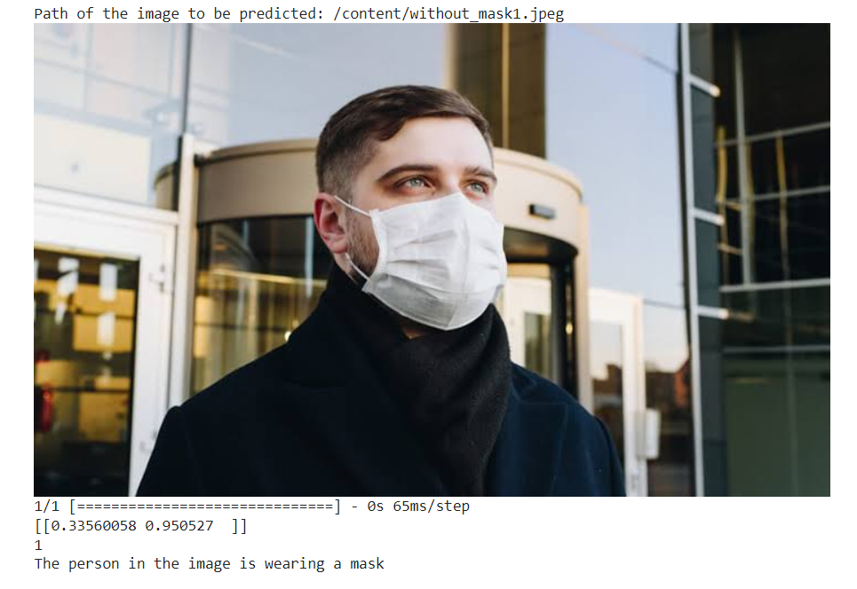
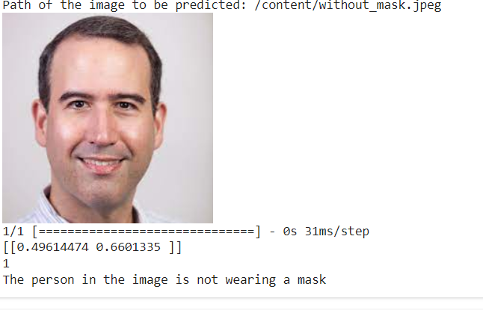
RESULTS
11

Slide 12
Evaluation:
The model was tested on separate validation and testing sets to assess its generalization ability.
Results show promising performance across all metrics, indicating the model's effectiveness in detecting face masks.

Slide 13
conclusion
Our project successfully developed a Convolutional Neural Network (CNN)-based system for face mask detection.
Through meticulous data preprocessing and model training, we achieved promising results in accurately identifying individuals wearing face masks.

